Slide 1
Planning presentation

Slide 2
Introduction
Create an Artificial Intelligence
Game not solved
Made to be difficult for computers
ARIMAA
MCTS Algorithm
Optimization by parallelization

Slide 3
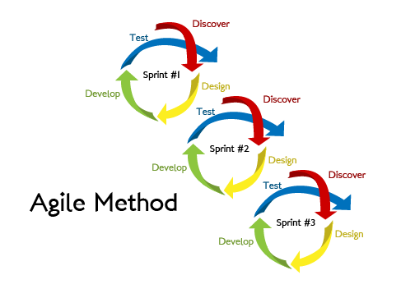
Development Methodology
Agile Methodology:
Iterative software development
methodology for building and
testing the software incrementally.

Slide 4
Key Areas:
Regular meetings
"To Do" list
Estimation of time and resources
Prioritization of tasks
Development using top to bottom approach
Feedback from the end user or the team
Iteration

Slide 5

Planning Poker Estimation Technique
Method for workloads
The method:
Guess workloads individually
No influence on the others
The treatment of solutions:
Eliminate singular guesses
Discuss together what will be the workload then

Slide 6
Environment
Human resources:
Team of 6 until January
Team of 3 after January
Technological resources:
Computers from INSA's computer science department
Grid'5000, a set of clusters of multi-core machines

Slide 7
Risks analysis
Kinds of risk:
1) Resources
2) Organisation
3) Payments
4) Suppliers/Purchases
5) Technical
=> unavoidable
=> none
=> none
=> none

Slide 8
Risks analysis
Kinds of risk:
5) Technical
=> Unexpected bugs can occur during the development
=> interoperability problems (Grid'5000 = linux, we currently use Windows)
Solution : dedicate enough time to fix them.
Solution : regular tests at the computer science department

Slide 9
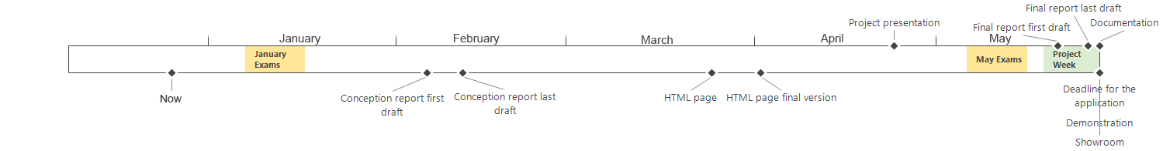
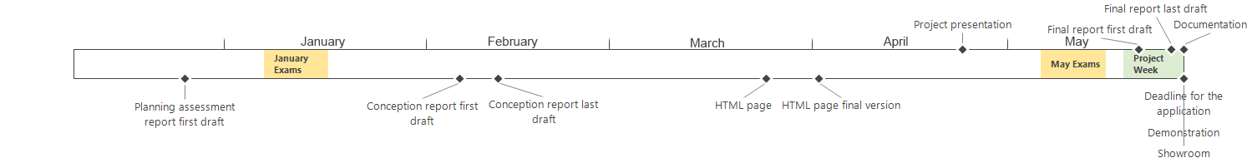
Important dates

Slide 10
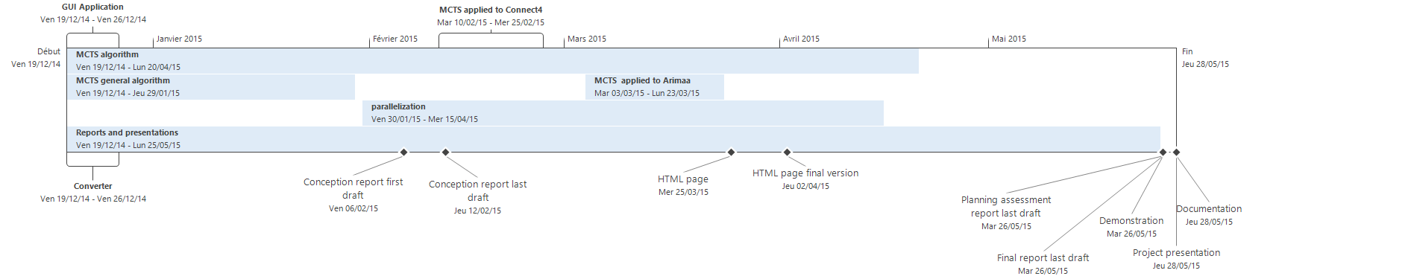
Tasks planning

Slide 11
Conclusion
Agile methodology along our project
Poker method to get a better estimation of the workload
Analysis of Environment
Internal and external resources
Dates
Risks
Schedule based on the aforementioned results

